Slide 1
Integrating NetBox and Ansible with Catalyst Center and Meraki as part of a modern Network Automation Architecture
Rich Bibby, Technical Advocate, NetBox Labs @rich_bibby
CISCOU-2039

Slide 2

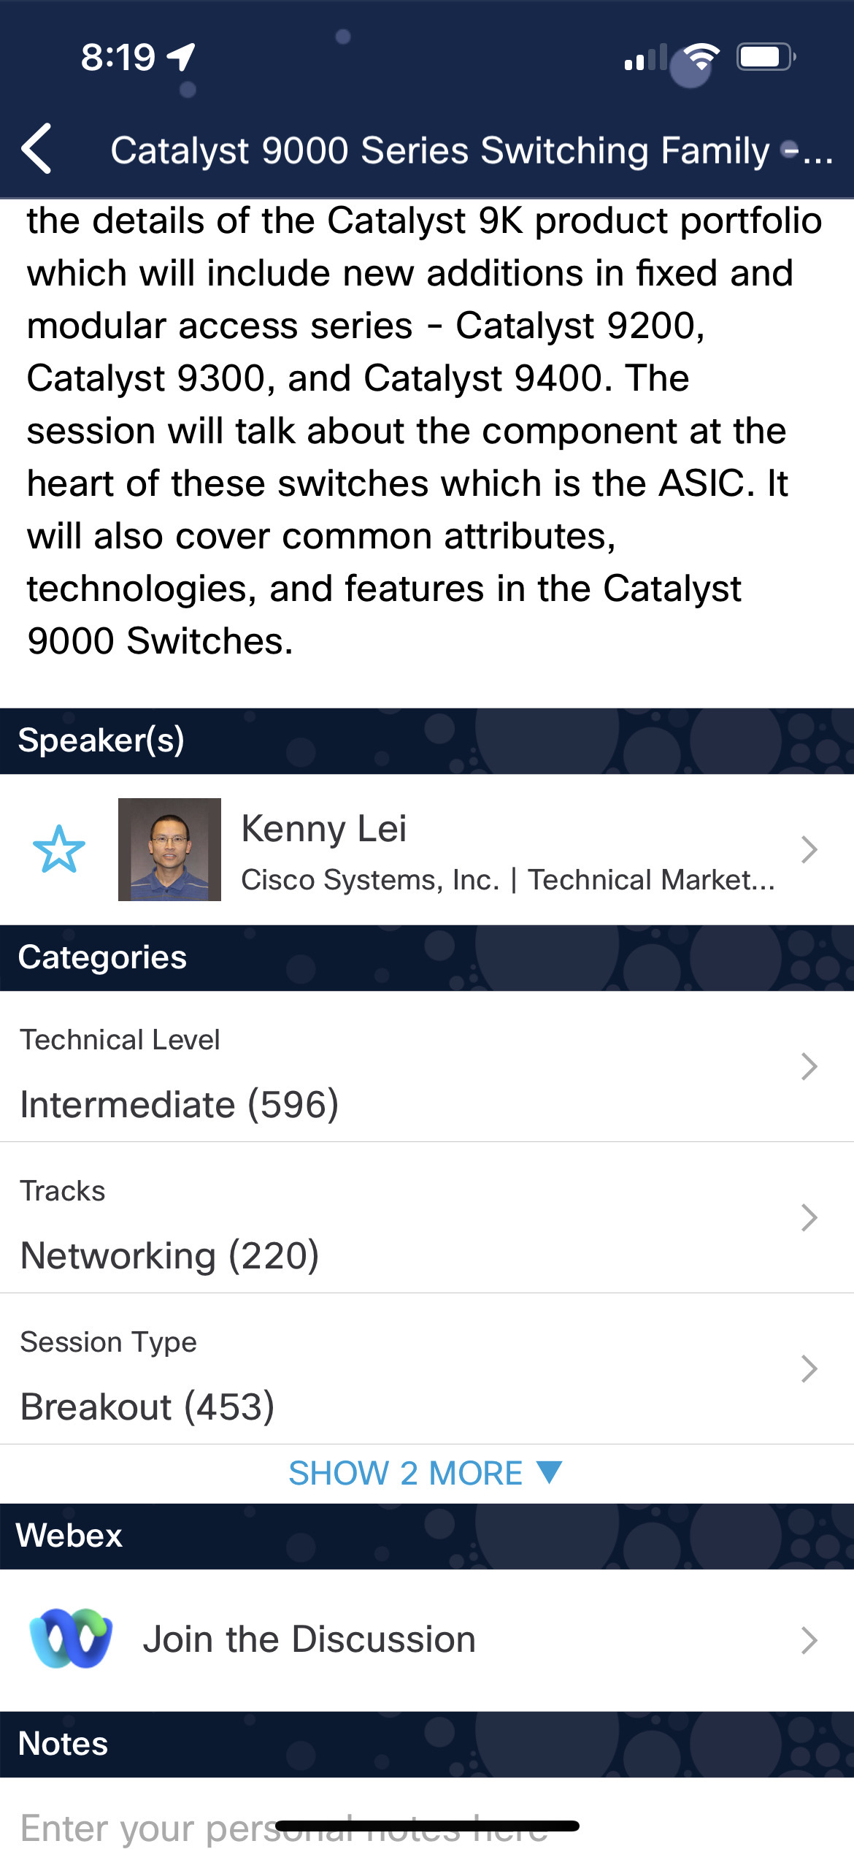
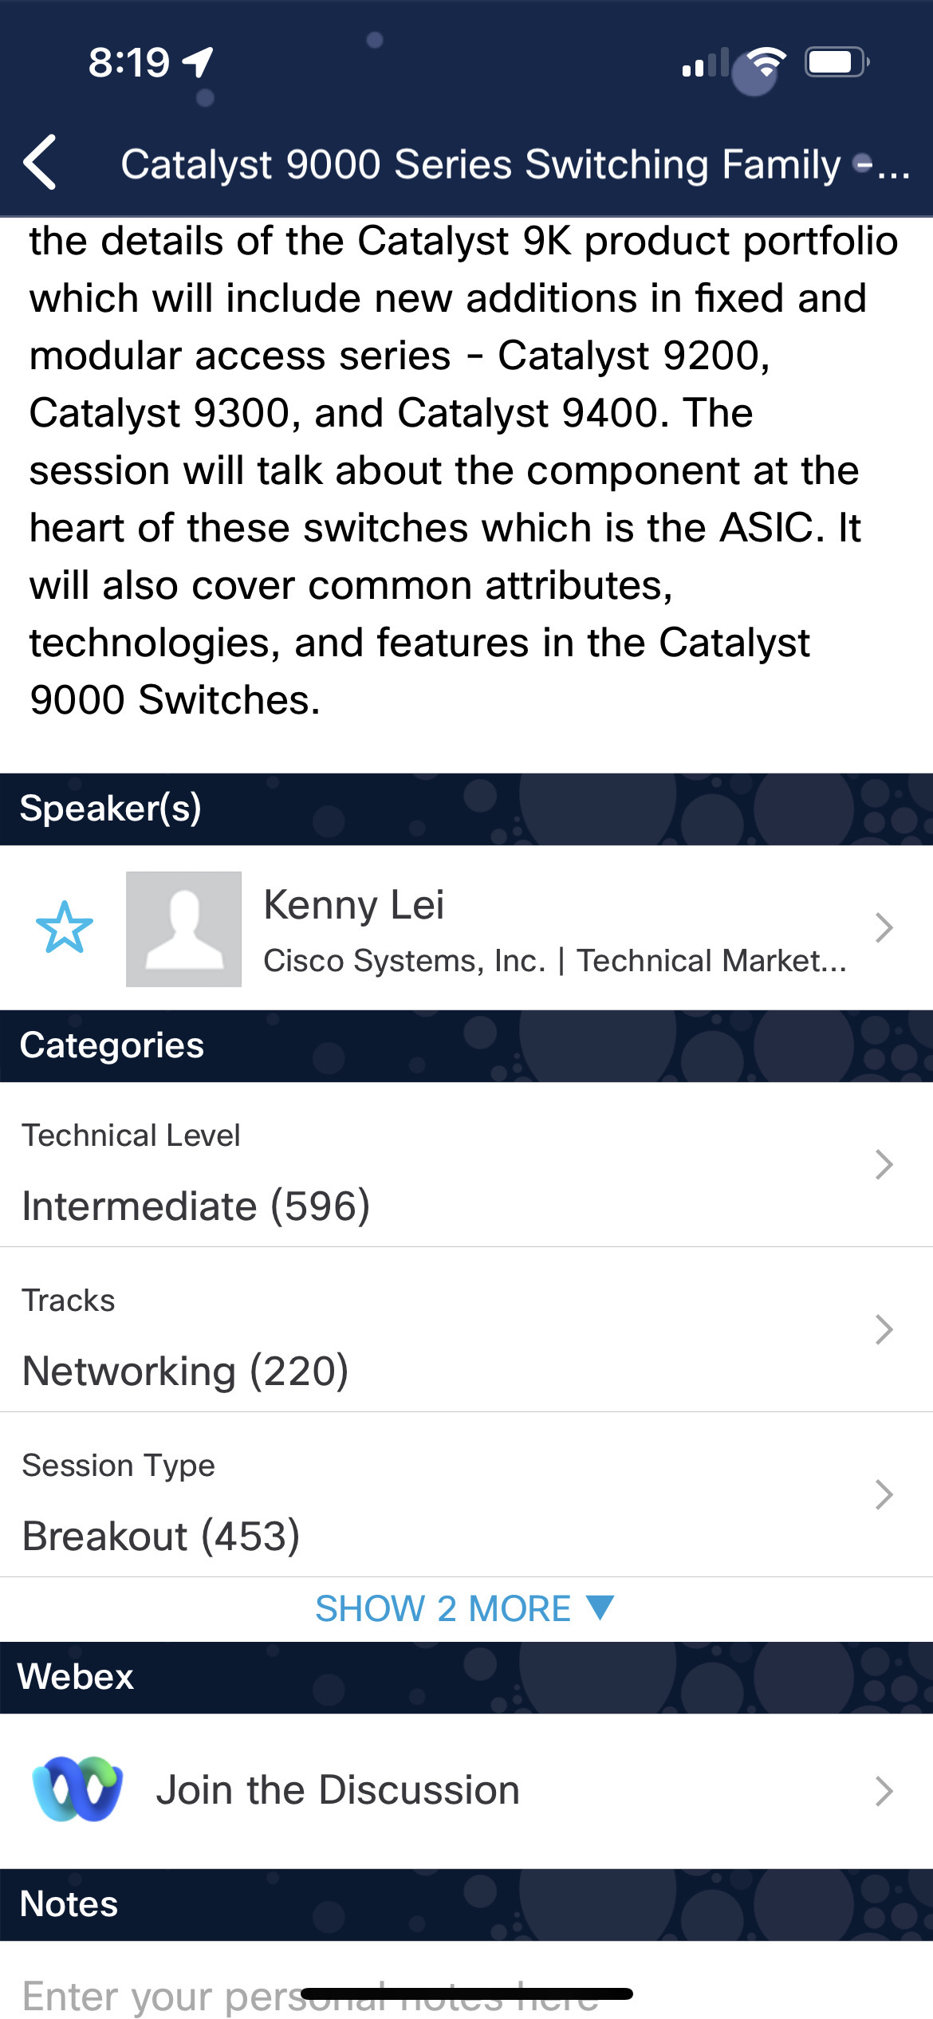

Cisco Webex App
https://ciscolive.ciscoevents.com/ ciscolivebot/#BRKXXX-xxxx
Questions? Use Cisco Webex App to chat with the speaker after the session
How
1
Find this session in the Cisco Live Mobile App
Click “Join the Discussion”
Install the Webex App or go directly to the Webex space
Enter messages/questions in the Webex space
2
3
4
Webex spaces will be moderated by the speaker until June 7, 2024.
Enter your personal notes here
© 2024 Cisco and/or its affiliates. All rights reserved. Cisco Public

Slide 3
Introducing NetBox
A reference architecture for modern network automation
Integrating NetBox with Catalyst Center & Meraki Networks
Ansible Collection for NetBox
Demo – Putting it all together

Slide 4
NetBox Labs
Founded in 2023 in NYC
Commercial steward of NetBox OSS
World class team built & lead NS1, founded the NetBox project
World Class investors & customers
“We make it easier to build and manage complex networks.”

Slide 5
Network Automation Requires a Network Source of Truth (NSoT)
NSoT: representation of the intended configuration and state of the devices, connections, and services of the network
Captures intended state - different than operational state
Structured, cohesive, comprehensive data model for network intent - forces completeness & correctness in design, planning, configuration management, operations

Slide 6
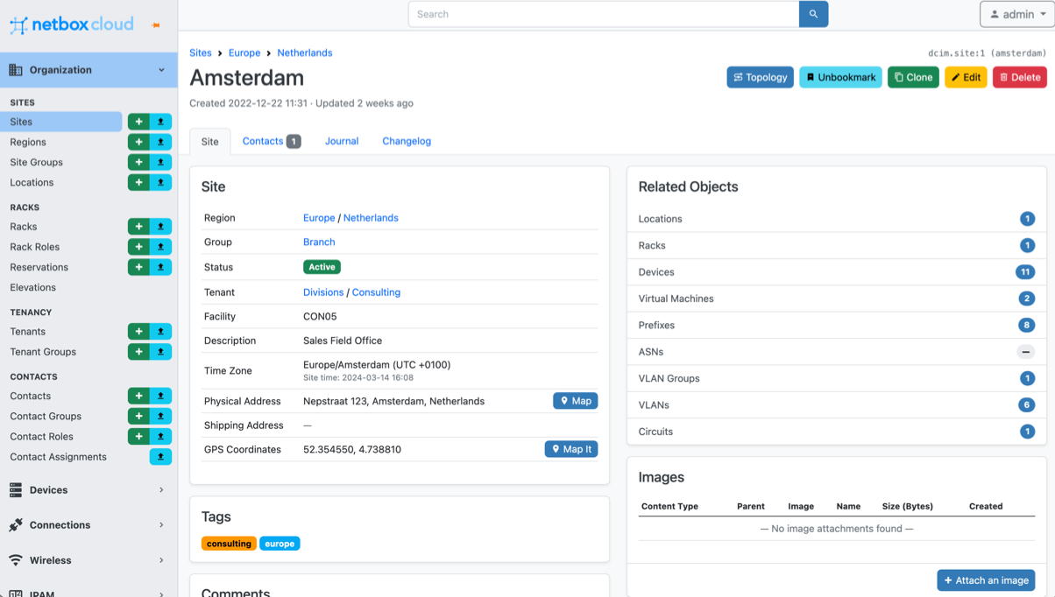
NetBox – Your Network Source of Truth
Your system of record for network management & automation
Eliminate spreadsheets
Break down DCIM & IPAM data silos
Accelerate network automation (REST API, GraphQL, Webhooks etc)
Everything is in NetBox and everything is correlated

Slide 7
The journey to network automation starts with implementing a NSoT
Document
Model
Automate
Converge legacy sources of truth
Discovery or manual capture of additional network data
Change operational processes to start with documentation
Connect network data through cohesive models
Enforce consistency across models
Implement change management starting with NSoT / intent
Generate configs from model data
Drive automations from dynamic inventory
Assurance to identify/resolve operational drift

Slide 8
NetBox is Powered by a Massive Community
5000+ Networking pros building, helping, sharing - 24x7
10K+ Global deployments
15k+ GitHub ⭐ Widely loved by networking teams
11k+ Software commits. Feature complete, battle tested

Slide 9
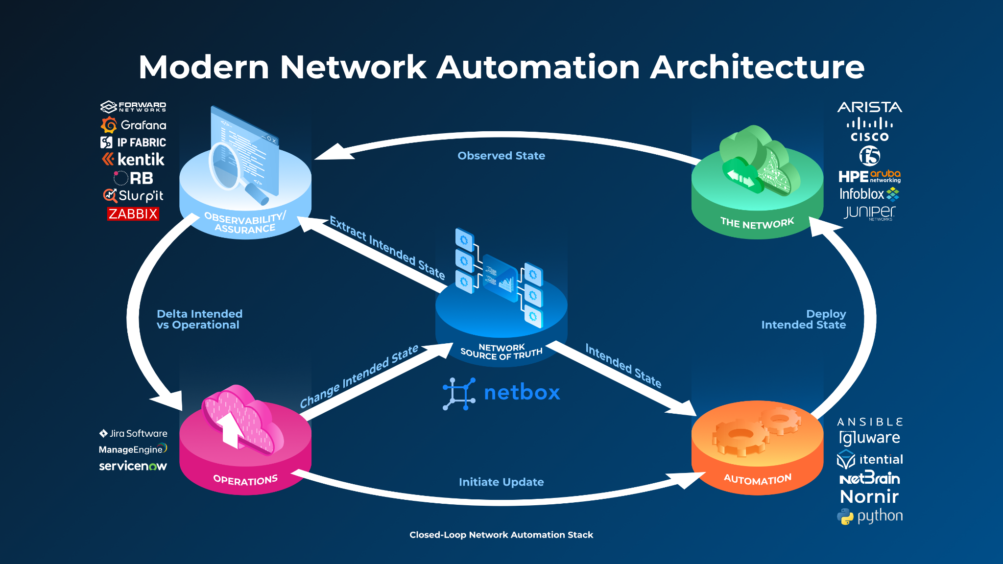

Slide 10
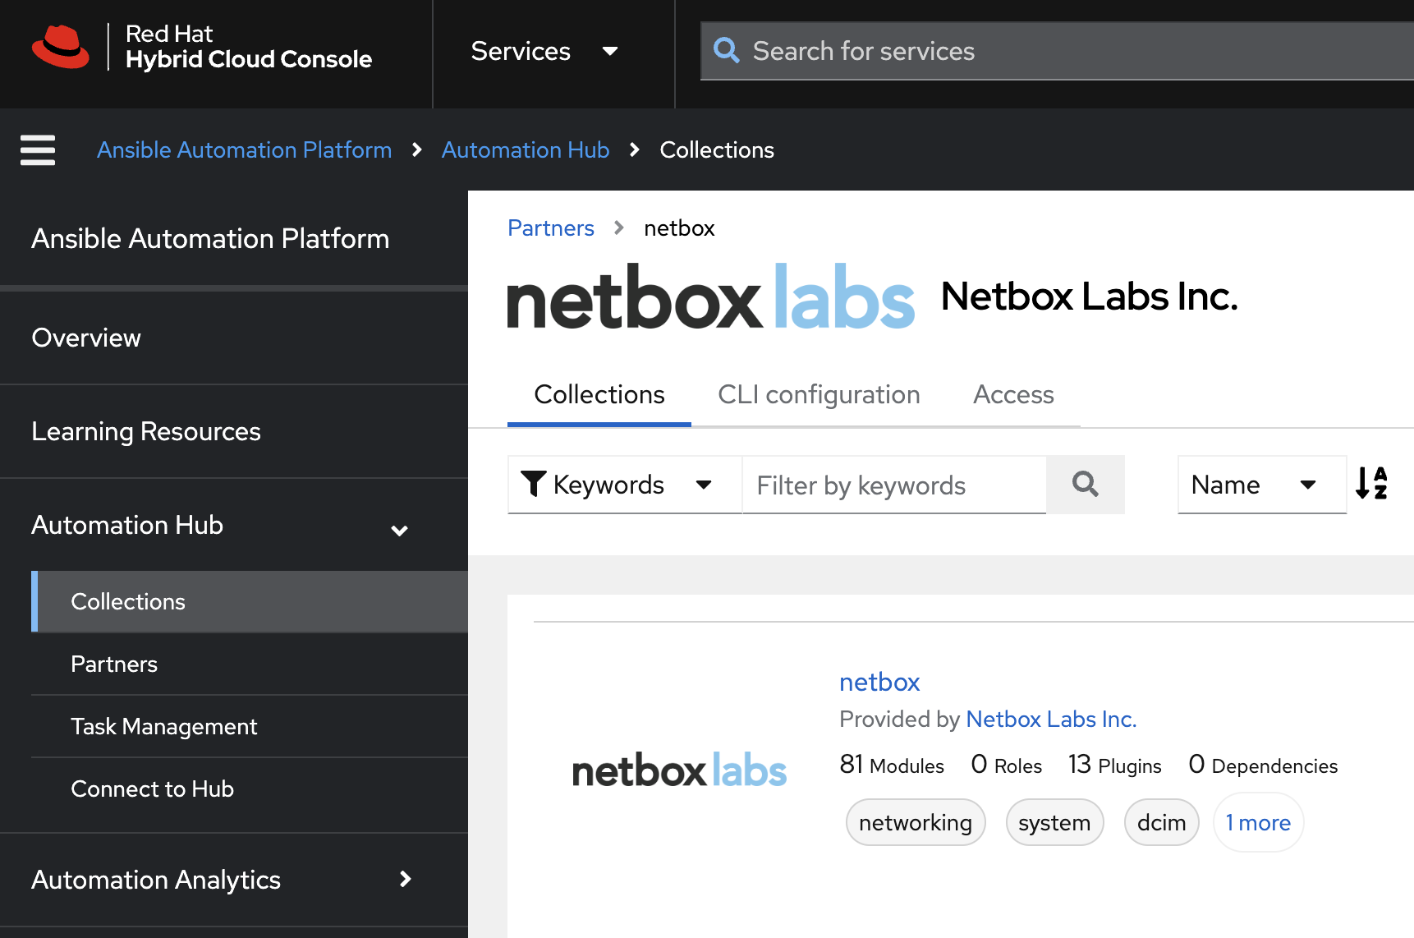
Ansible Certified Collection for NetBox
Modules to define the intended network state in NetBox
Plugins to drive automation of the network using data from NetBox
Official support from NetBox Labs and Red Hat for customers
Available from Ansible Automation Hub (certified collection) or Ansible Galaxy

Slide 11
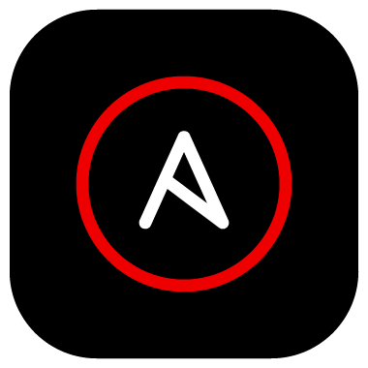

Automating Cisco Controller Based Networks
Catalyst Center Controller
Meraki Cloud Controller
R-1
SW-1
SW-2
AP-1
SW-1
FW-1
Session ID CISCOU-1014
11

Slide 12
Demo

Slide 13

Continue your education
Accompanying Git Repository
Visit the On-Demand Library for more sessions at www.CiscoLive.com/on-demand
Contact me at: rbibby@netboxlabs.com

